Slide 1
Scientific Machine Learning for Modeling, Optimization, and Control of Dynamical Systems
Ján Drgoňa
Associate Professor Civil and Systems Engineering Department The Ralph O'Connor Sustainable Energy Institute (ROSEI)
Data Science and AI Institute (DSAI)

Slide 2
Course Syllabus
Week 1: Introduction to Scientific Machine Learning (SciML)
Week 2: Preliminaries and Introduction to differentiable programming
Week 3: Physics-informed neural networks (PINNs)
Week 4: Neural ordinary differential equations (NODEs)
Week 5: Learning to optimize (L2O)
Week 6: Differentiable control
Week 7: Neural differential equations with constraints
Week 8: Feasibility restoration methods in L2O
Week 9: Safety filters for learning-based control
Week 10: SciML applications
Week 11: Project evaluation with presentations
Week 12: Project evaluation with presentations

Slide 3
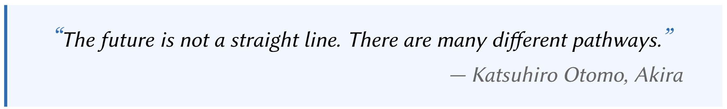

Neural Differential Equations (NDEs)
R. T. Q. Chen, et al., Neural Ordinary Differential Equations, 2019

Slide 4
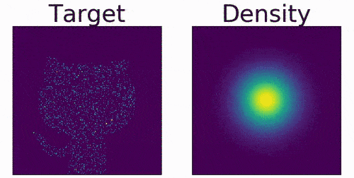
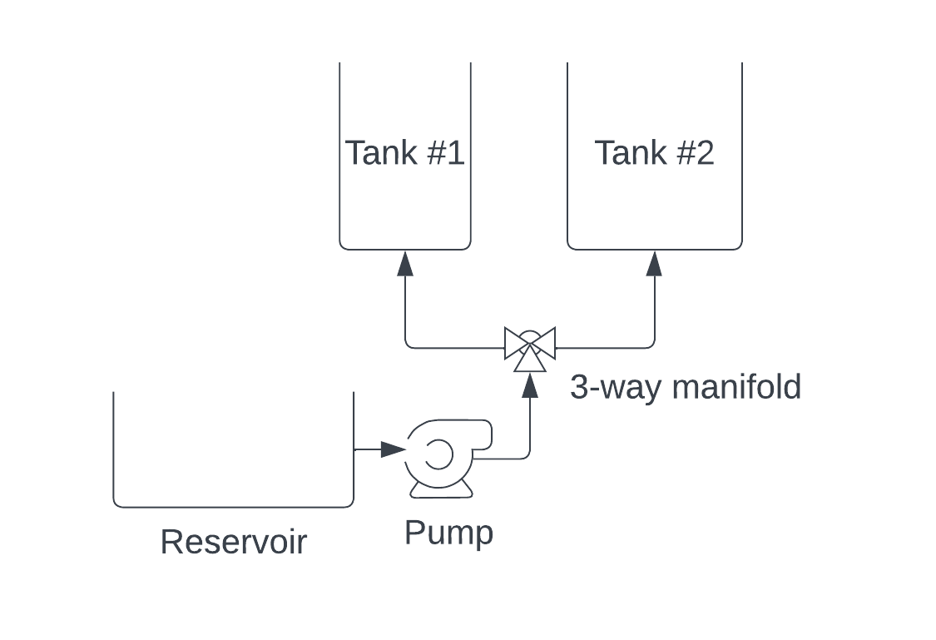
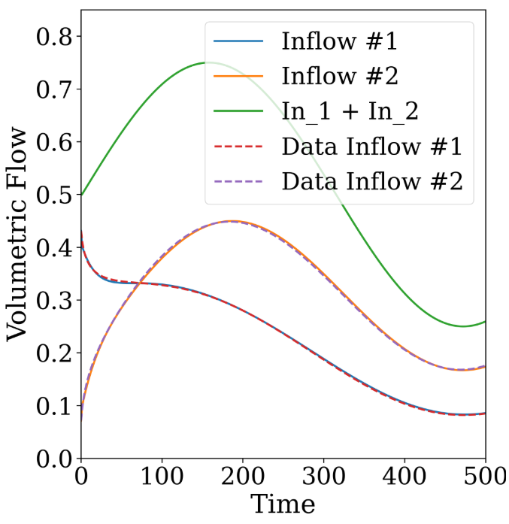
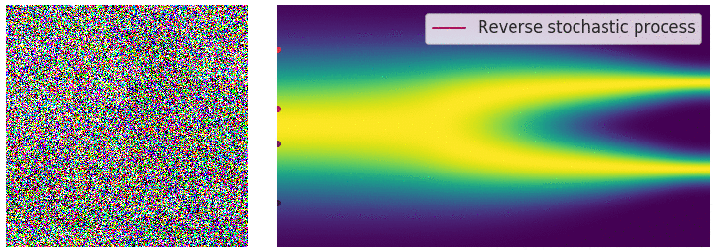
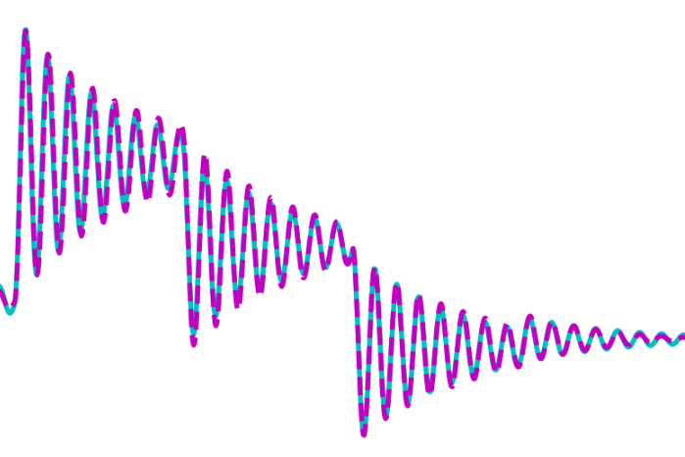
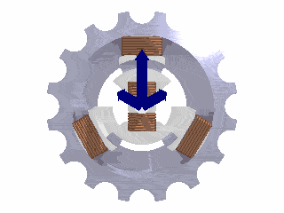
Neural Differential Equations (NDEs) Applications
Generative AI: normalizing flows
Engineering systems modeling
Will Grathwohl et al., "FFJORD: Free-form Continuous Dynamics for Scalable Reversible Generative Models." ICLR, 2019.
James Koch, et al., Learning Neural Differential Algebraic Equations via Operator Splitting, CDC, 2025
Generative AI: diffusion-based models
Power systems modeling
Yang Song, et al., Score-Based Generative Modeling through Stochastic Differential Equations, ICLR 2021. Image from https://yang-song.net/blog/2021/score/
X. Kong, et al., Dynamic Parameter Estimation with Physics-based Neural Ordinary Differential Equations, IEEE PESGM, 2022

Slide 5
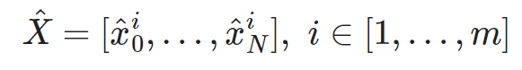
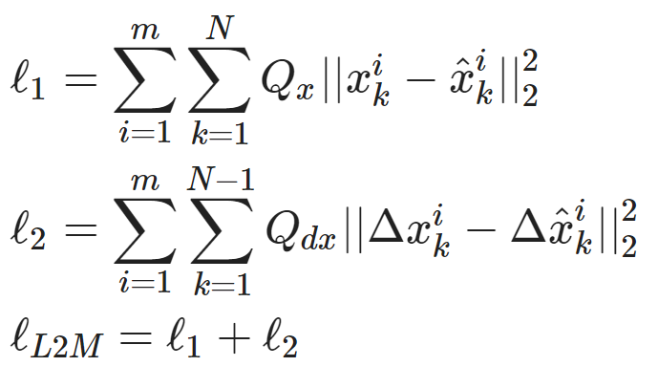
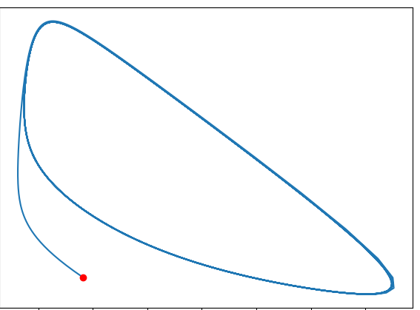
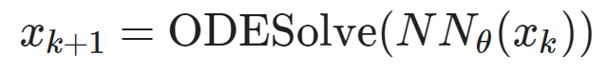
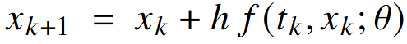
Components of Neural Differential Equations (NDEs)
Dataset: time-series of states, inputs, and disturbances tuples.
Architecture: differentiable ODE solver with neural network model.
Loss function: trajectory matching, regularizations, and constraints penalties.
Explicit Euler ODE solver:
https://github.com/pnnl/neuromancer/blob/master/examples/ODEs/Part_1_NODE.ipynb
R. T. Q. Chen, et al., Neural Ordinary Differential Equations, 2019

Slide 6
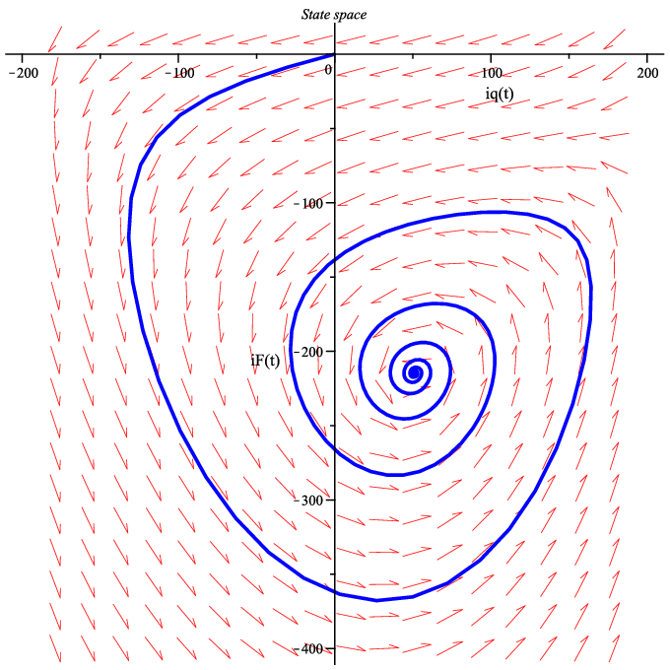
Dynamical Systems Jargon
State space: the set of all possible states the system can be in.
Dynamics map: describes how the system evolves over time. Either described by differential (continuous tine) or difference equations (discrete time).
Trajectory: the path a system follows through phase space.
Initial condition: specifies the starting state of a dynamical system at a given initial time.
Fixed point (equilibrium): a state where the system does not change.
Stable fixed point: nearby points move toward it, i.e., dynamics map is contracting.
Unstable fixed point: nearby points move away from it, i.e., dynamics map is expanding.
Example of a single trajectory with stable fixed point plotted over a vector field in 2D state space.
https://en.wikipedia.org/wiki/Dynamical_system

Slide 7
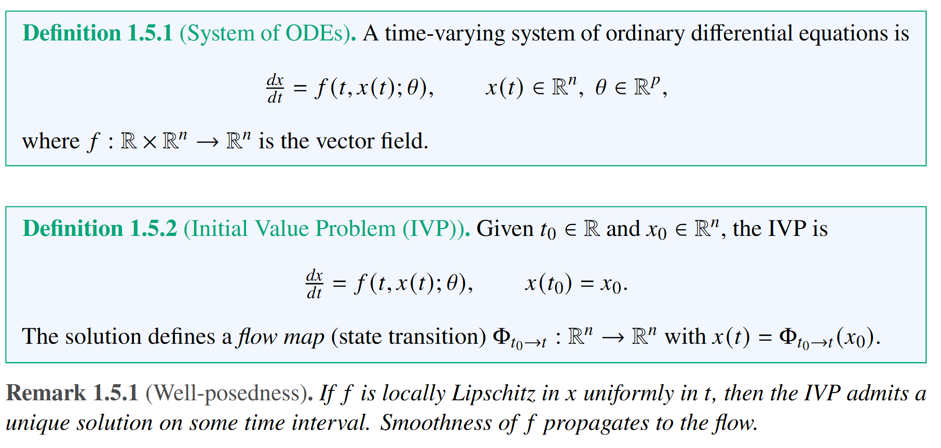
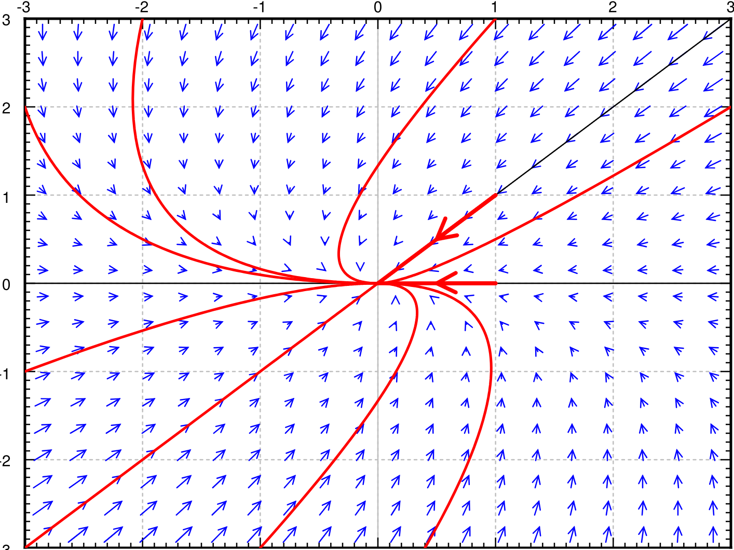
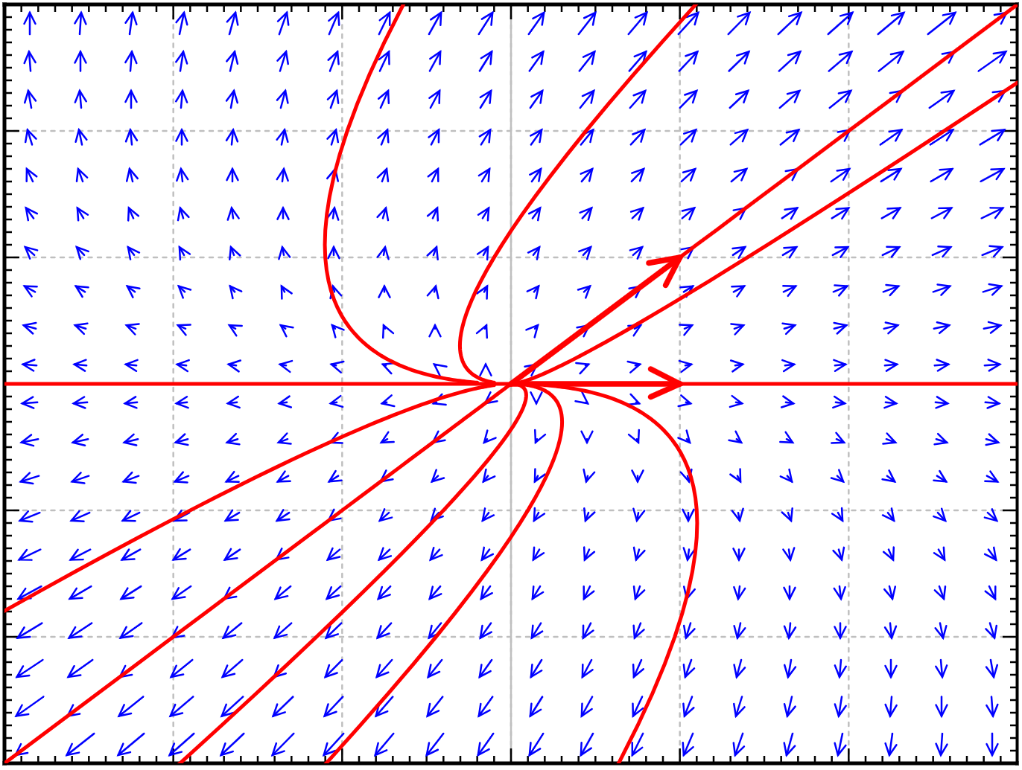
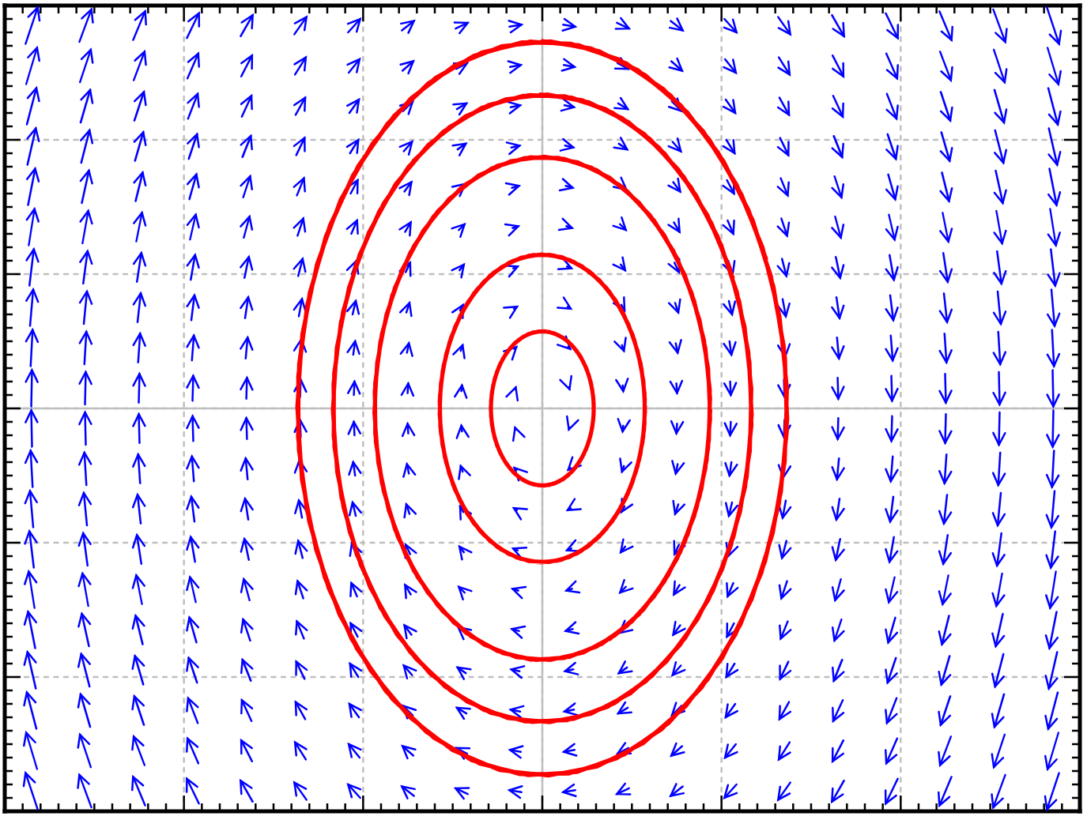
System of Ordinary Differential Equations (ODEs)
stable
unstable
Energy-conserving
https://web.uvic.ca/~tbazett/diffyqs/diffyqs.html

Slide 8
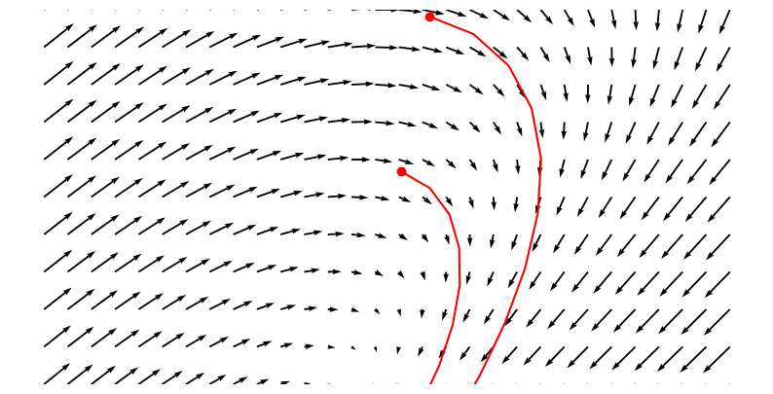
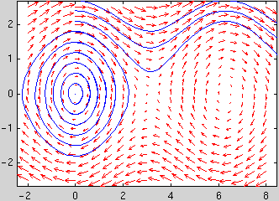
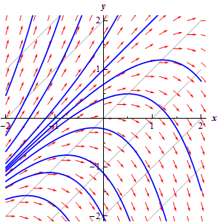
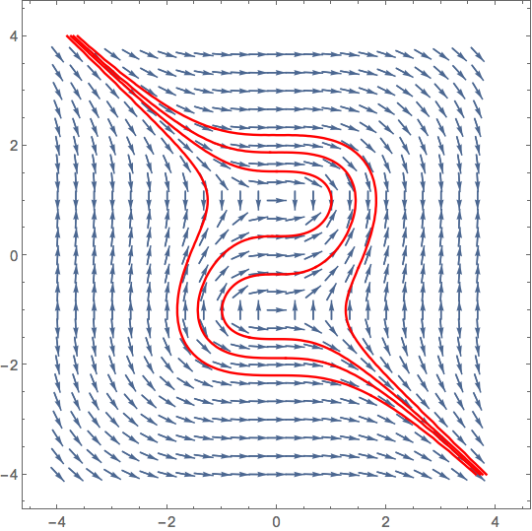
ODE Initial Value Problem
Different initial conditions yield different solutions trajectories determined by the underlying vector field.

Slide 9
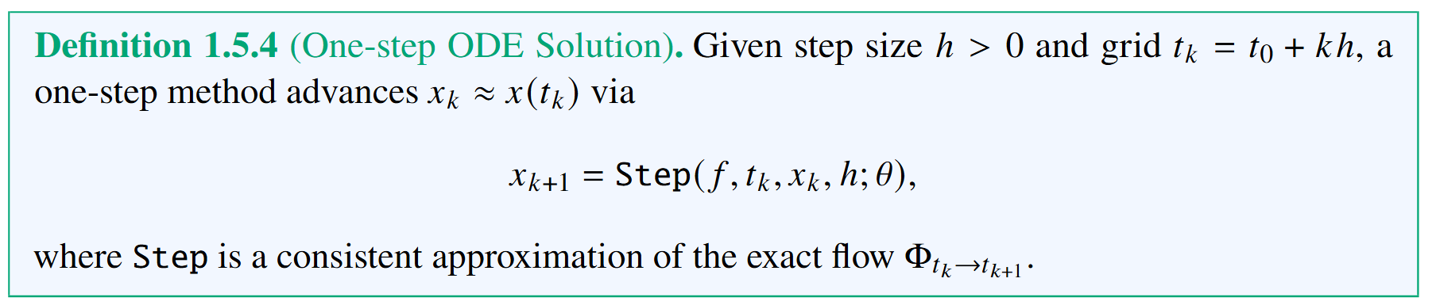
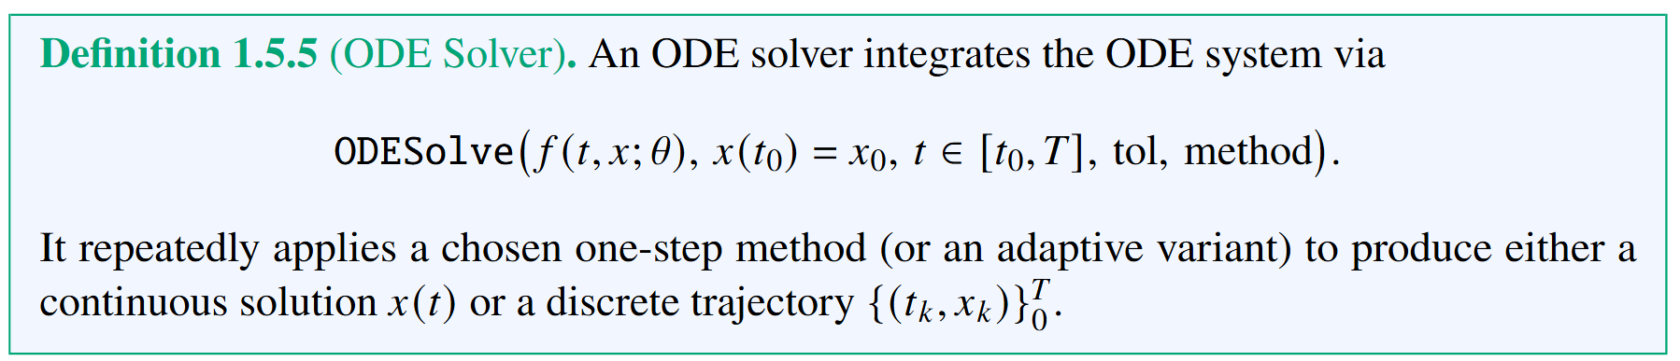
ODEs Solver

Slide 10
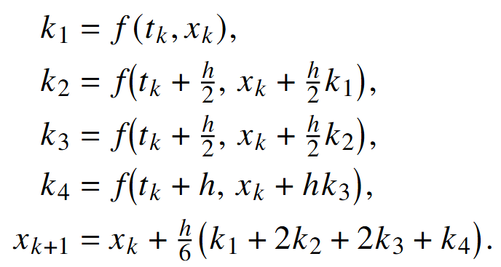
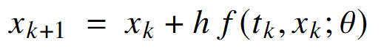
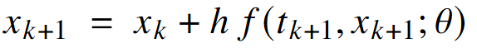
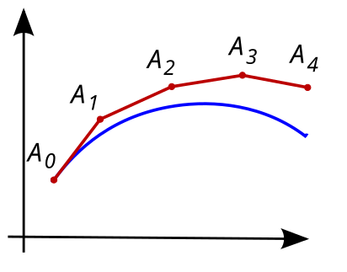
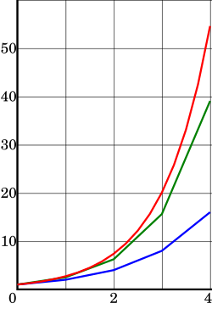
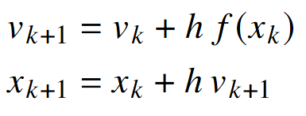
Family of ODEs Solvers
Explicit Runge–Kutta 4 (RK4, order 4).
Explicit Euler (order 1)
Implicit Backward Euler (order 1).
Semi-Implicit (Symplectic) Euler.
https://en.wikipedia.org/wiki/Numerical_methods_for_ordinary_differential_equations

Slide 11
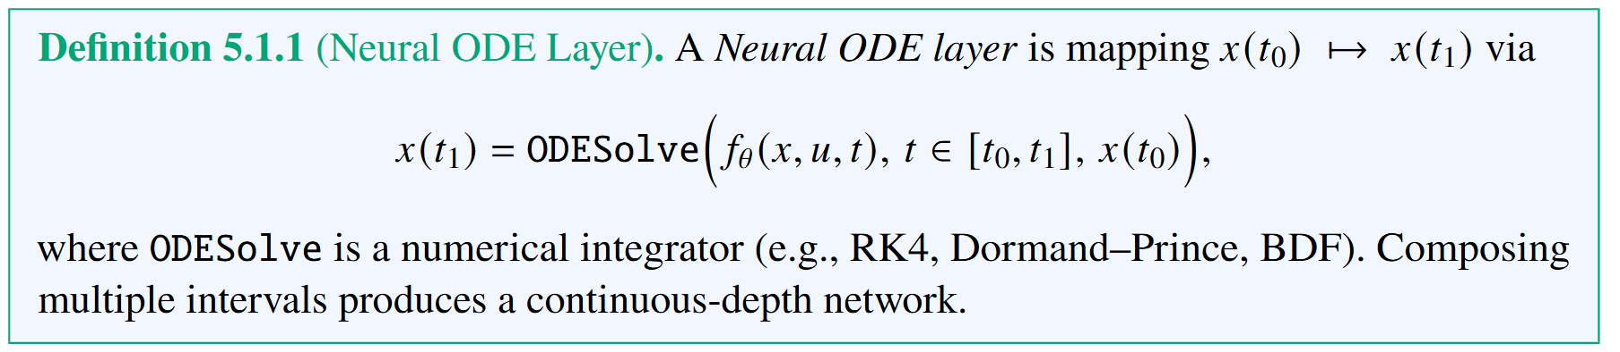
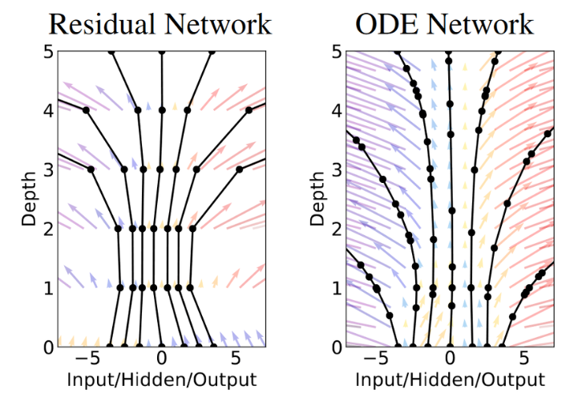
Neural Ordinary Differential Equations (NODEs)
R. T. Q. Chen, et al., Neural Ordinary Differential Equations, 2019

Slide 12
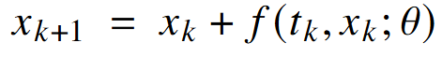
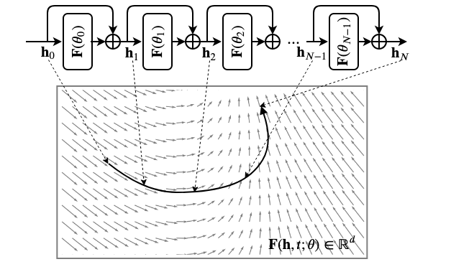
ResNet vs NODE
Residual Neural Network (ResNet)
Explicit Euler (order 1)
https://ayandas.me/blogs/2020-03-20-neural-ode R. T. Q. Chen, et al., Neural Ordinary Differential Equations, 2019

Slide 13
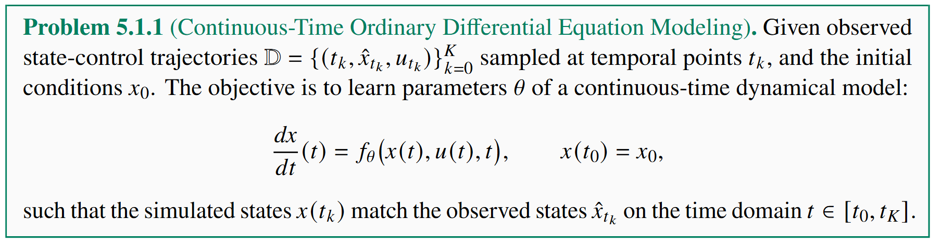
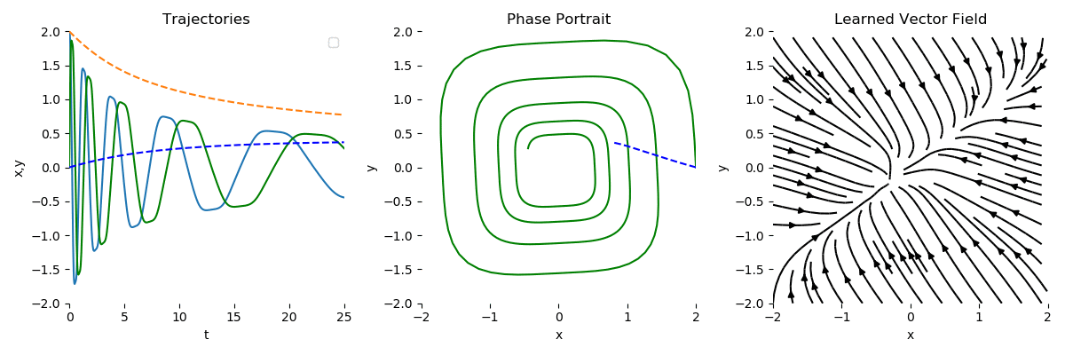
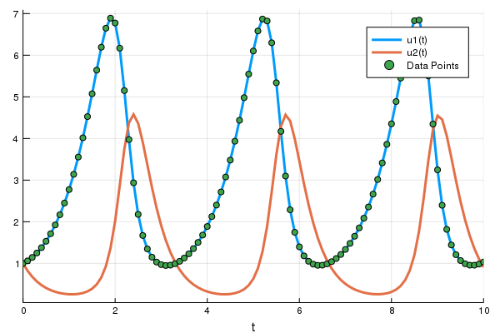
Data-Driven NODE Modeling Problem
R. T. Q. Chen, et al., Neural Ordinary Differential Equations, 2019
docs.sciml.ai/DiffEqDocs/stable/

Slide 14
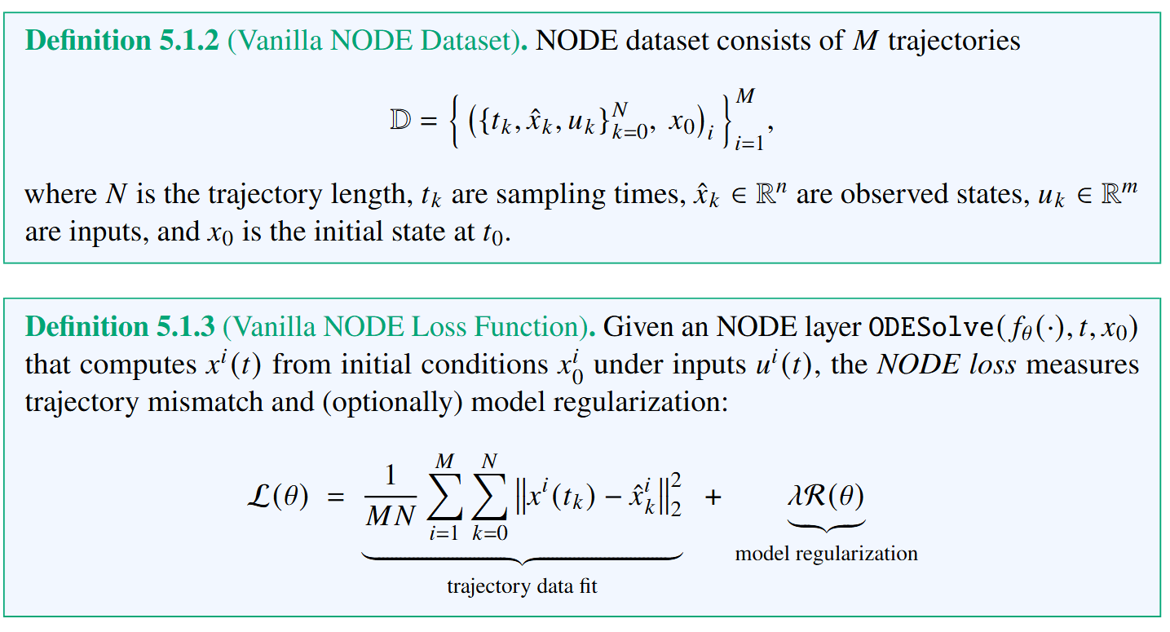
NODE Dataset and Loss Function

Slide 15
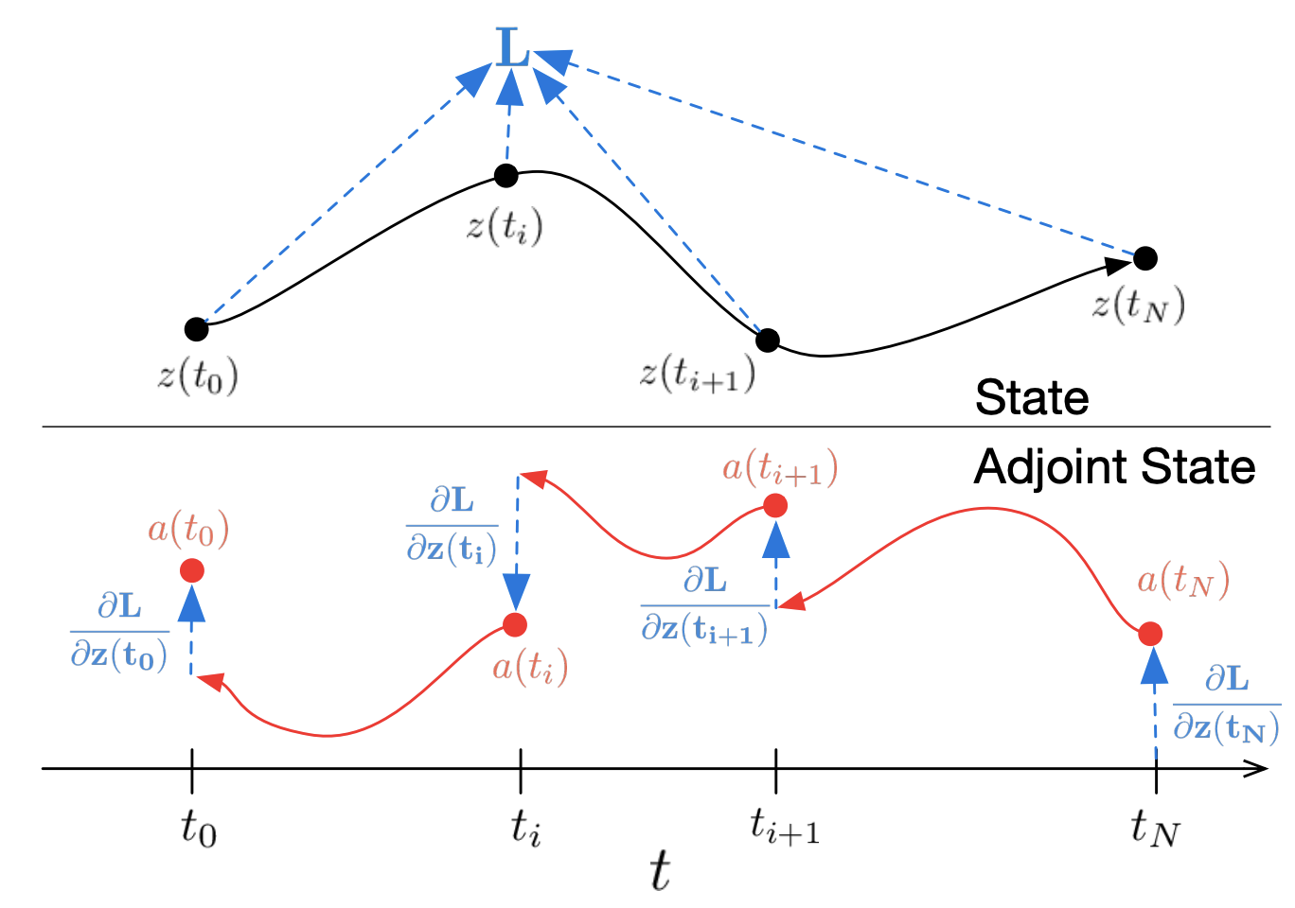
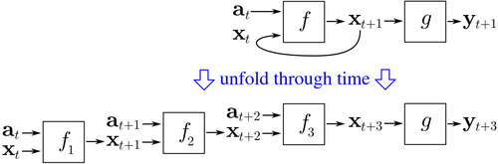
Differentiating Through ODEs Solvers
Backpropagation through time (BPTT)
Adjoint sensitivity method
Pros: exact for discretized systems, numerically more stable, wide support in modern AD libraries
Cons: high memory cost, requires storing all intermediate variables
Pros: memory efficiency, no need to store intermediate variables, strong theory
Cons: error accumulation leading to numerical instability
https://en.wikipedia.org/wiki/Backpropagation_through_time
R. T. Q. Chen, et al., Neural Ordinary Differential Equations, 2019

Slide 16
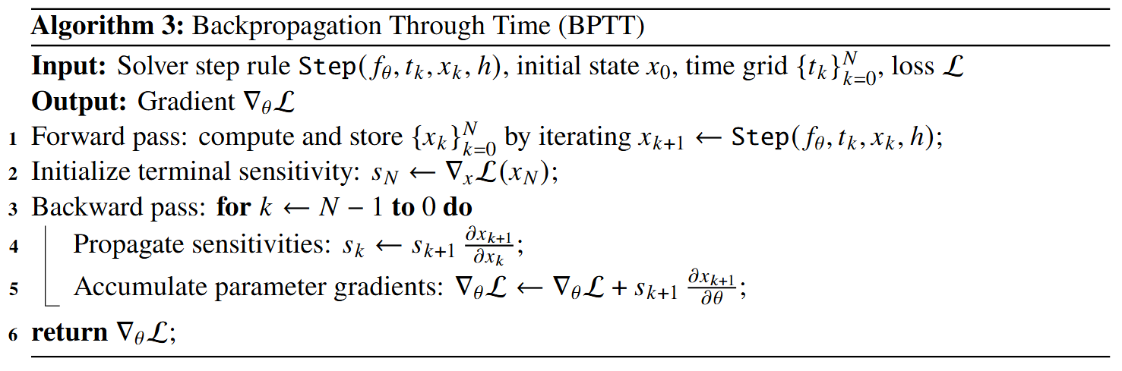
Backpropagation through time (BPTT)

Slide 17
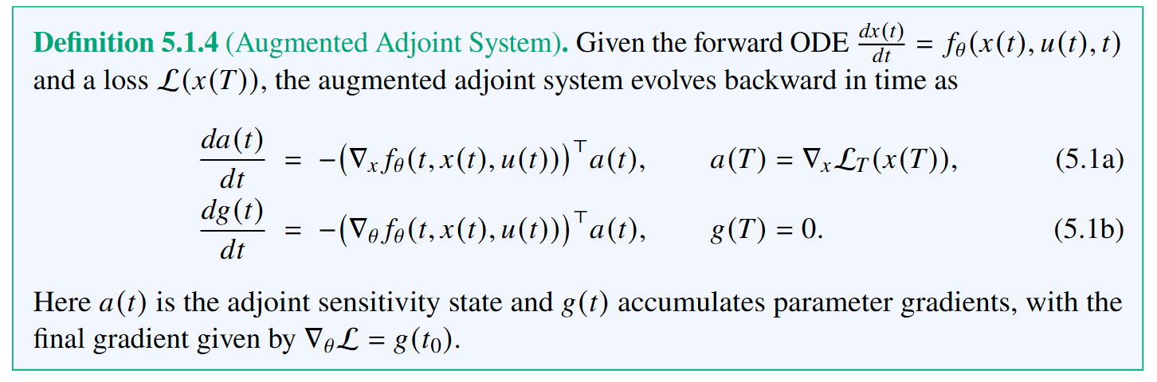
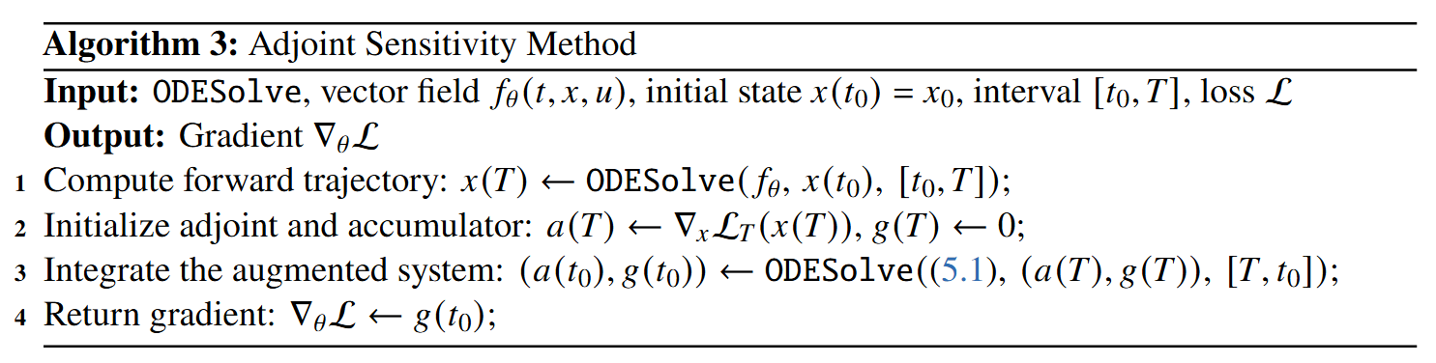
Adjoint Sensitivity Method (Continuous-time BPTT)

Slide 18
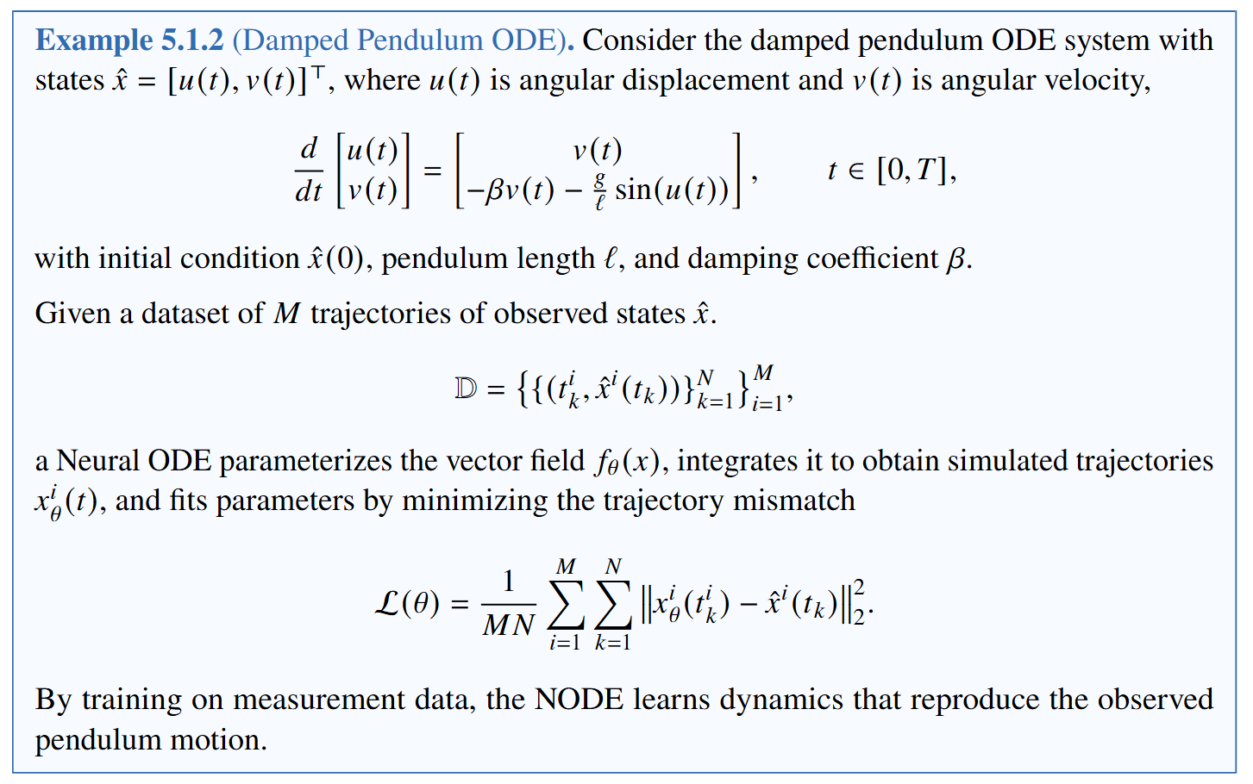
System Identification with Neural ODE Example

Slide 19
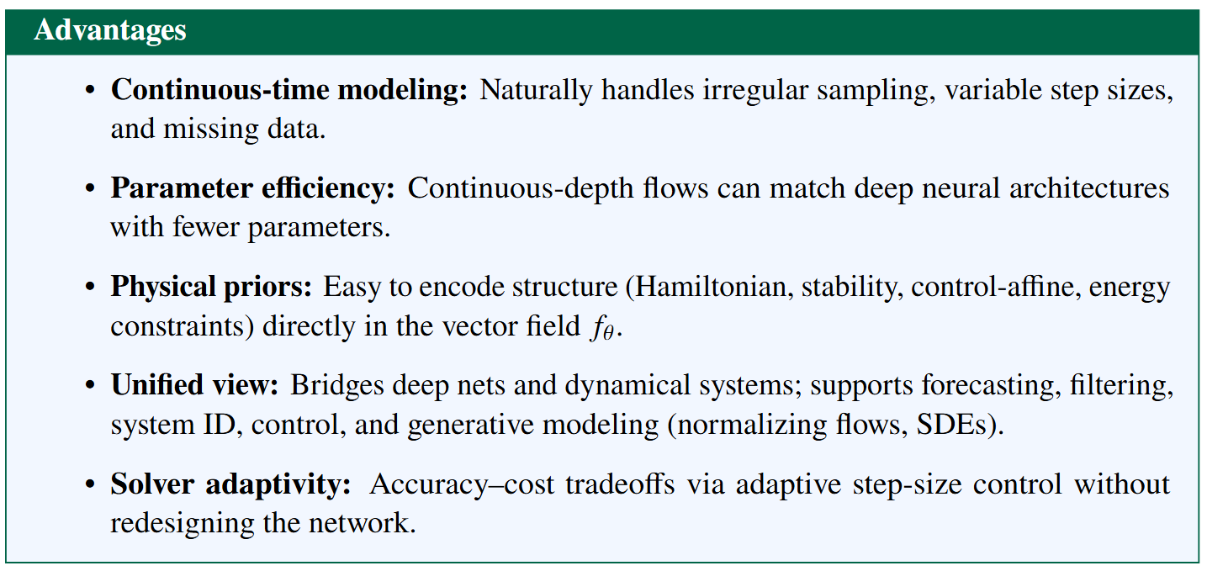
NODE Advantages

Slide 20
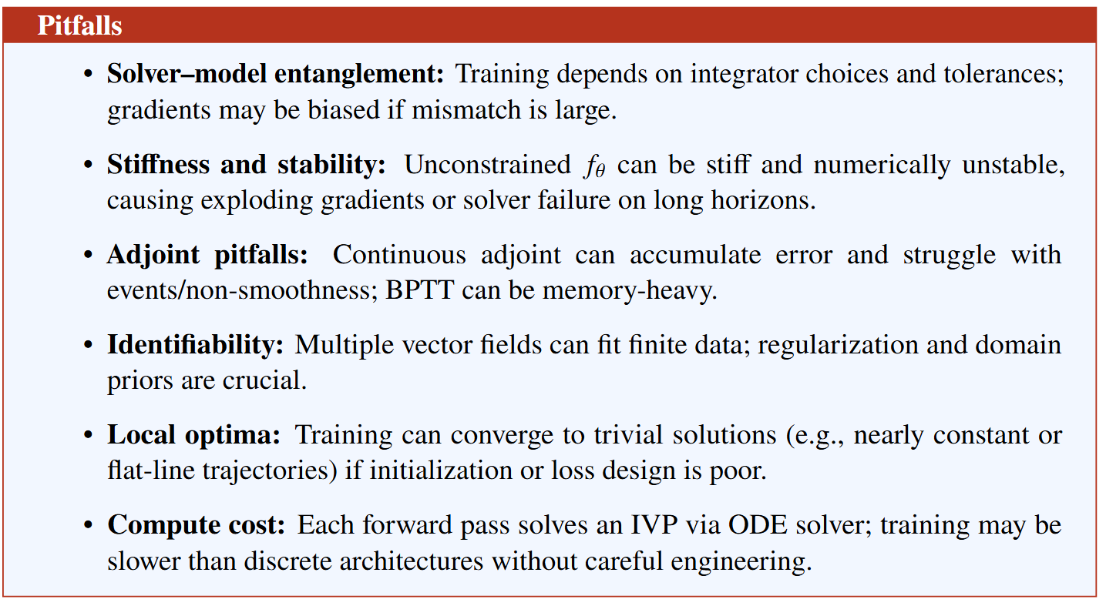
NODE Challenges

Slide 21
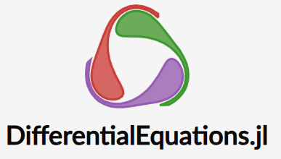



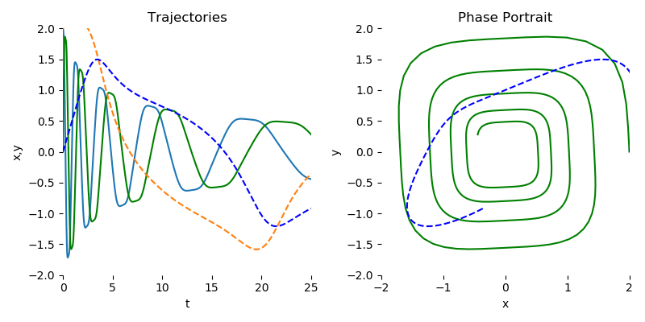
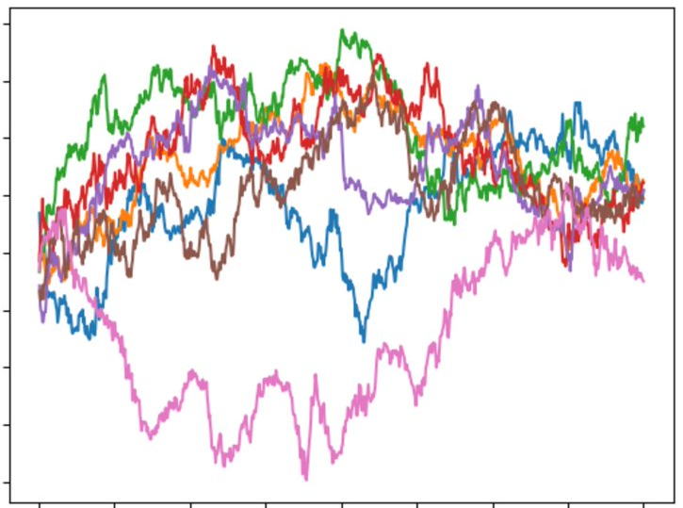
NODE Open-Source Software Libraries
docs.sciml.ai/DiffEqDocs/stable/
docs.sciml.ai/DiffEqFlux/stable/
github.com/DiffEqML/torchdyn
Diffrax
github.com/rtqichen/torchdiffeq
docs.kidger.site/diffrax/
github.com/pnnl/neuromancer

Slide 22

NDEs in NeuroMANCER Scientific Machine Learning Library
NDE Examples
Neural Ordinary Differential Equations (NODEs)
Parameter estimation of physics-based ODEs
Universal Differential Equations (UDEs)
NODEs with control inputs
Sparse Identification of Nonlinear Dynamics (SINDy)
Function Encoders Neural ODEs
Neural Differential Algebraic Equations (NDAEs)
github.com/pnnl/neuromancer

Slide 23
References
Adjoint Sensitivity Method and Backpropagation Through Time
Dreyfus, S. E. (1962). “The Numerical Solution of Variational Problems”. In: Journal of Mathematical Analysis and Applications
Cao, Y., S. Li, L. Petzold, and R. Serban (2003). “Adjoint Sensitivity Analysis for Differential-Algebraic Equations: The Adjoint DAE System and Its Numerical Solution”. In: SIAM Journal on Scientific Computing
Cao, Y., S. Li, and L. Petzold (2002). “Adjoint sensitivity analysis for differential-algebraic equations: algorithms and software”. In: Journal of Computational and Applied Mathematics
Werbos, P. J. (1990). “Backpropagation through time: what it does and how to do it”. In: Proceedings of the IEEE
Neural Ordinary Differential Equations
R. T. Q. Chen, et al., Neural Ordinary Differential Equations, NeurIPS, 2019
Patrick Kidger, On Neural Differential Equations, arXiv:2202.02435, 2022
Facundo Sapienza, et al., Differentiable Programming for Differential Equations: A Review, arXiv:2406.09699v1, 2024
C Rackauckas, Q Nie, DifferentialEquations.jl – A Performant and Feature-Rich Ecosystem for Solving Differential Equations in Julia, Journal of Open Research Software, 2017
https://implicit-layers-tutorial.org/neural_odes/
https://ayandas.me/blogs/2020-03-20-neural-ode
https://iclr2020deepdiffeq.rice.edu/

Slide 24
Homework
HW1: Implement NODE to fit nonlinear ODE of your choice (e.g., Lorenz attractor, Van Der Pol oscillator, Lotka Volterra, Three-body problem, Double pendulum, Elastic pendulum, …) other than damped pendulum.
Compare trained NODE solution against ground truth solution obtained by solving known ODE system, obtained e.g., via scipy.integrate
Optional:
Compare NODE solutions obtained with adjoint sensitivity method (e.g. torch.diffeq) vs BPTT
Compare NODE solutions with different neural architectures (number of layers, number of hidden neurons, activation functions)
Submit as single .ipynb jupyter nobetook file that includes the code, markup description, and figures plotting the solution.
Few open-source benchmark implementations of nonlinear ODEs:
https://github.com/dynamicslab/sindy-original-example/tree/30f4dcd
https://github.com/pnnl/neuromancer/blob/master/src/neuromancer/psl/autonomous.py
https://github.com/SciML/SciMLBenchmarks.jl

Slide 25
Week 11: Project Presentations and Evaluation
Projects cover 70% of the course grade!
Project proposal 20% - week 5
Project progress report 10% - week 8
Project final report 20% - week 10
Project presentation 20% - week 11
Project format.
Project technical report: 4 to 6 page long pdf document including references and figures.
Project presentation: ppt or pdf slides, 15 min time slot per student in week 11.
Admissible topics.
Application of selected SciML methods to problems inspired by real-world applications
e.g., L2O for large scale optimization of energy systems.
Development of new methods tackling some of the open challenges in SciML
e.g., novel way of utilizing PINNs in differentiable control for PDEs.
New theory supporting selected SciML methodology
e.g., convergence analysis of feasibility restoration layers in L2O.

